Slide 1
Annotating Digital Documents
L3

Slide 2
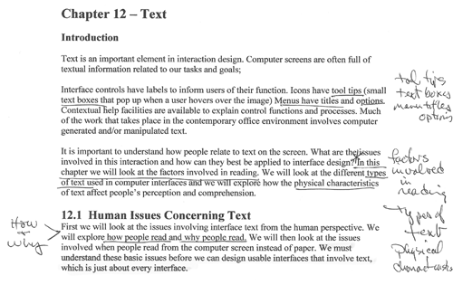
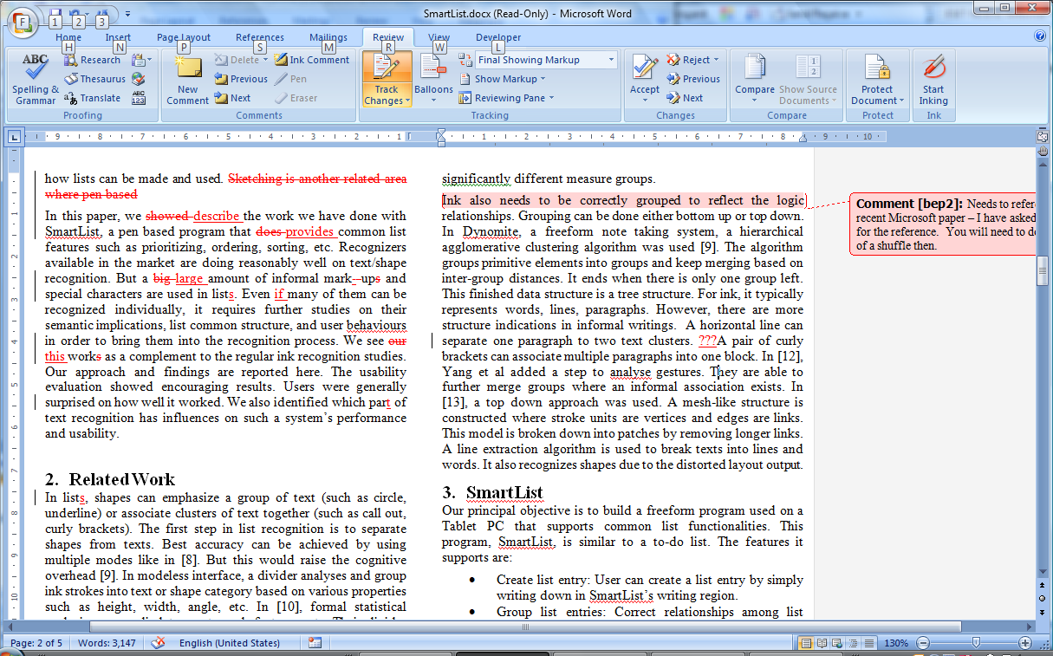

Slide 3
Ink Annotations are different to text annotations
Ink stands out from the original
It is free form – the annotator can
  Emphasize – underline, highlight, asterisk
  Question
  Agree
  Add side notes to explain, clarify
The authorship remains with the original author

Slide 4
Why do we annotate?
Active reading
  Adding annotations to a document helps the reader to process the information
Communicate with others/self
  When developing the document collaboratively
  When evaluating the work (eg marking assignments)

Slide 5
Expressiveness and usefulness
Annotations are very individualistic
However they can generally be understood by others.
Interesting studies of students choosing old – already annotated books – and looking carefully at the style of annotations
Also students understanding pre-annotated material more quickly than the original document

Slide 6
Visual message
Looking at an annotated document in an instant you understand the position of the annotator. Are they:
Being critical?
Correcting the spelling and grammar?
Adding their own explanatory notes

Slide 7
Example Software
Penmarked
  Assignment marking
RCA
  Code review

Slide 8
Penmarked Motivation
Electronic submission and marking of assignments is attractive to faculty and students alike
Particularly programs assignments when a digital copy of the assignment is required for marking
However providing meaningful feedback to students is more difficult
And individualised feedback is important

Slide 9
Design Brief
Annotation of the script
Score recording
Work practice support
  Who wants to ‘waste time’ marking?

Slide 10
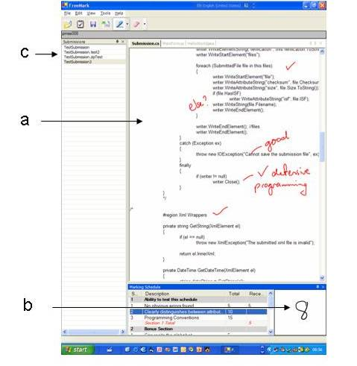
Implementation

Slide 11
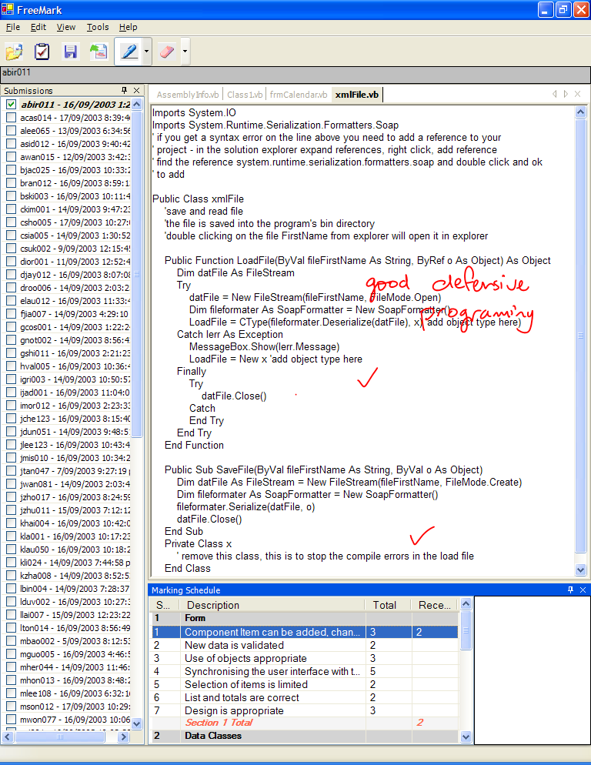
Annotation Pane
Ink anywhere
Erase
Multiple files
A technical nightmare!
  Two layers
  Lots of Windows API calls
We have more-or-less got pdf going

Slide 12
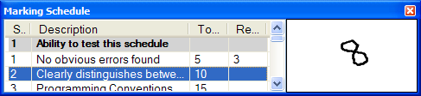
Scoring Pane
Marking rubric
Numeric scores
Entered
  in score box with pen and recognized using Microsoft recognition engine with numeric factoid feature also range checked
  Or through the keyboard

Slide 13
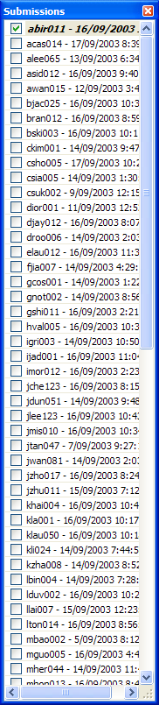
Work Practices Support
Pre-marking
Set up of marking rubric, directories, file type/name filters
Collection of assignments from a dropbox or directory structure
During
All assignments listed in student list pane
  Can be marked as opened and complete
Automatic unpackaging of zip files
Direct link to student’s folder for executing program
On completion
Exporting of marks as xml file
Conversion of assignments to pdf files (includes mark rubric and annotated files)
Email return of assignment to student

Slide 14
Evaluation 1
Iterative informal during development
Usability testing with think aloud
  Talking while marking a program is challenging
  A few interaction problems
    pen/keyboard input
    ‘do you want to save’ dialogue
  Recognition required correct formation of digits
  Using the pen to interact with non-tablet programs (the students assignments) is slow!
Focus group
  Student list and workflow support invaluable
  Accurate writing required for score recognition

Slide 15
Evaluation 2
One large programming class ~ 180 students
Six markers
Three assignments
  increasing and size and complexity
Three treatments
  Paper
  ‘Database’
  Penmarked
Balanced treatment
  Each student had one assignment marked by each process
  Each marker used each process
  Rotated so student – marker different for each assignment

Slide 16
Marking Time
minutes

Slide 17
Number of Annotations
Total number of annotations

Slide 18
Student Satisfaction – process
Voluntary survey 42 respondents
They did not like paper!

Slide 19
Student opinion aid to learning
Correlation between number of comments and students’ opinion of aid to learning.
(statistically significant)

Slide 20
Overall Preference
Overall preference for Penmarked

Slide 21
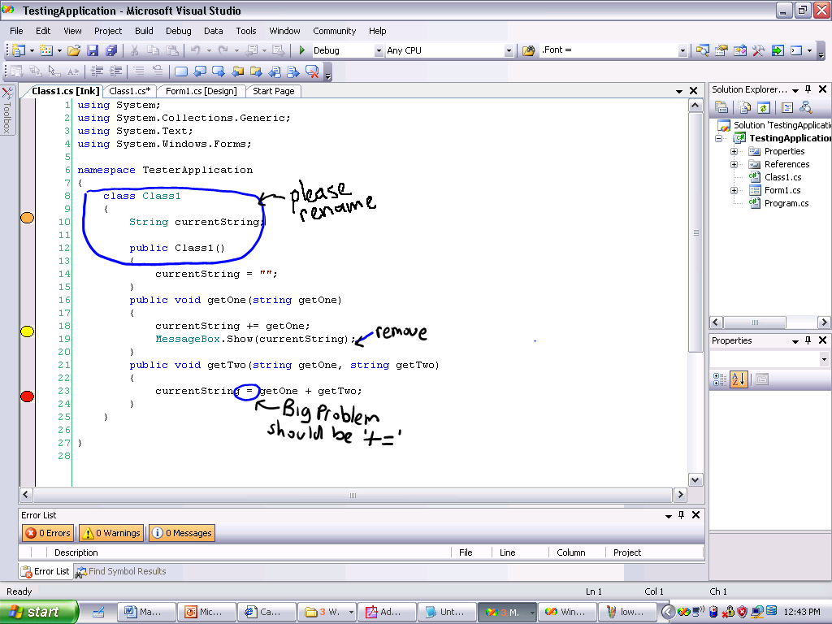
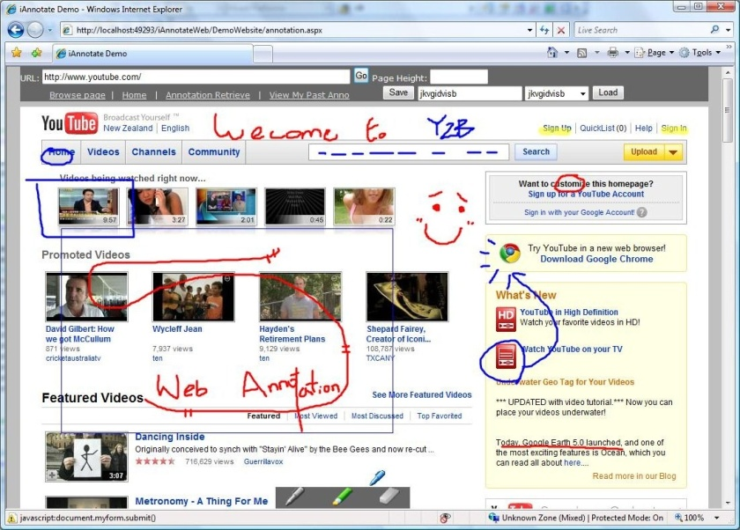
What else we could do with digital ink
IDEs
Web

Slide 22
RCA
One of the difficulties with Penmarked is that the markers have to go to another application to compile and execute the program
RCA is an annotation addin for Visual Studio

Slide 23
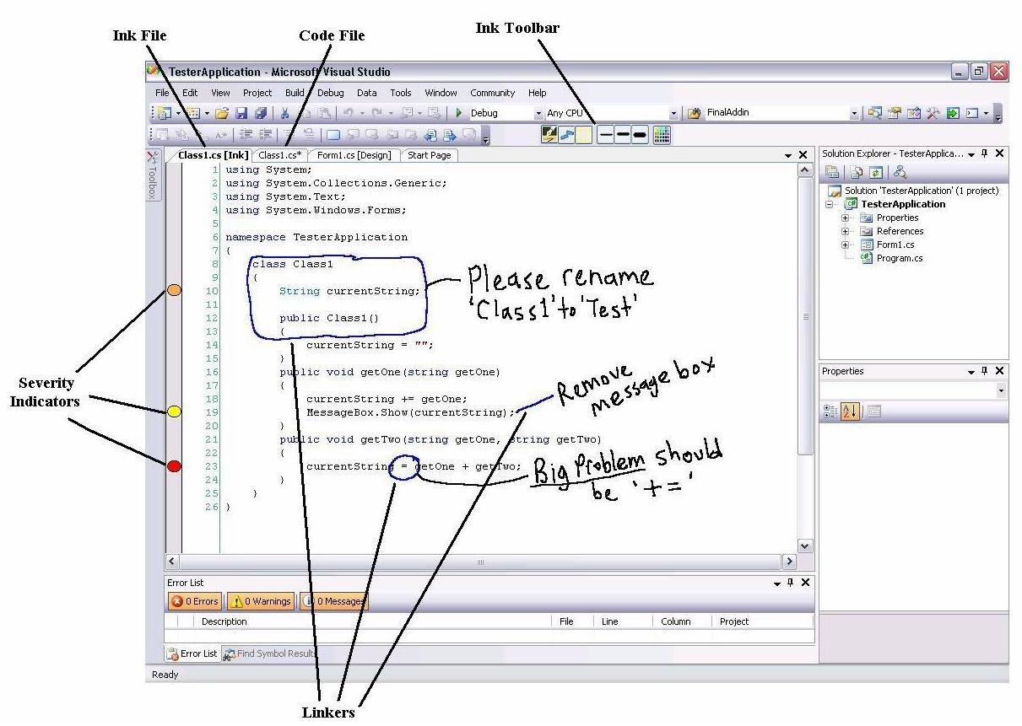
RCA in Visual Studio

Slide 24
Technically
Transparent overlay
  Another technical nightmare!
Each annotation consists of:
  A linker – line or circle
  Annotation – group text or diagram
  A severity indicator

Slide 25
CodeAnnotator
Same idea but trying to use Eclipse.
Added some navigation and character recognition
Pretty much the same problem!
No extensibility points from the code windows!

Slide 26
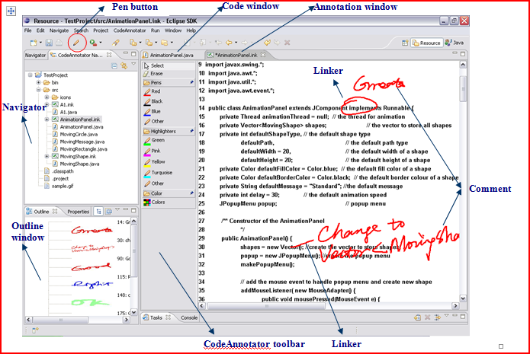
CodeAnnotator UI

Slide 27
Related Work
Paperless environments
  Sellen and Harper (2002)
Ink interaction
  Plimmer and Apperley (2003)
    Freeform - UI sketching environment
  Jarrett and Su (2003)
Annotation
  Marshall (1997)
  Shipman, Price et al (2003)
  Wolfe (2000)
Recognition
  Tablet OS
Marking software
  Heinrich and Lawn (2004)

Slide 28
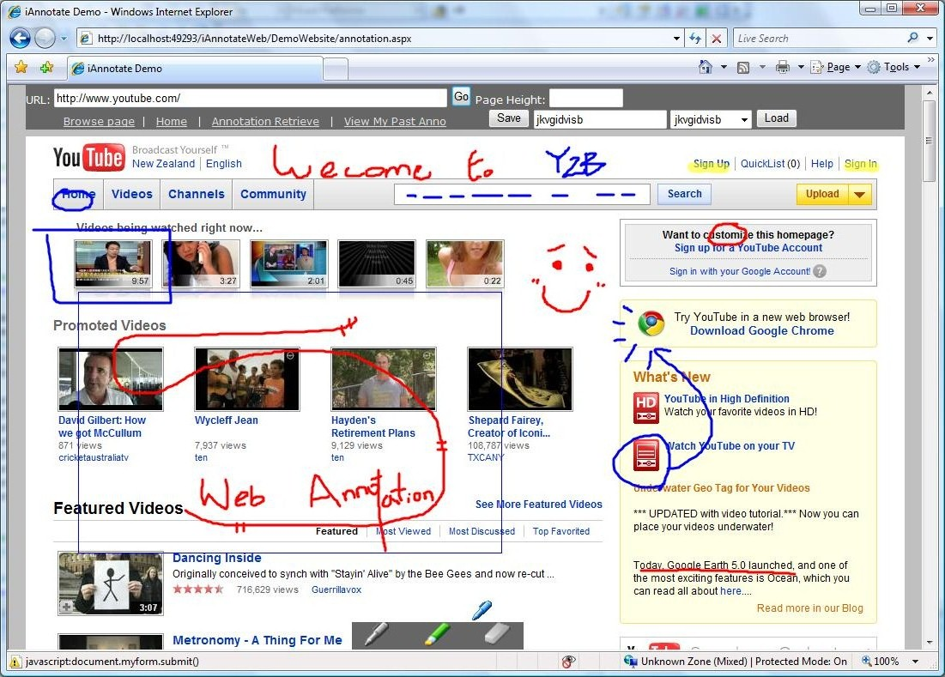
Browser Annotation
  http://prj-hcha155.cs.auckland.ac.nz/DemoWebsite/annotation.aspx
  Login and password ‘new3’ send bug reports ☺

Slide 29
Browser Annotation
Goal – an annotation toolbar
  Failed – can’t fire silverlight from the toolbar
Revised goal – copy web page and then annotate
  iFrame
  Java script
  Silverlight
  ASP .Net
  MySQL

Slide 30
Discussion
Why is it so difficult?
  There is a fundamental digital divide between text and images
  Trying to combine the two and keep them consistent is really difficult
  Knowing what to do with ink when the underlying document changes its problematic
  Many standard windows do not easily support non-text

Slide 31
Future Work
Visual studio 2010
  Yeah it works!
Annotation in web browsers …….

Slide 32
Finally
Going paperless requires
  Providing informal inking
  Reliable recognition (sometimes)
and
  Attending to work practices
  which are more varied than we first imagine!

